Slide 1
Predicting Hazardous Nearest Earth Objects (1910-2024)
Ahsan Khan
Introduction to Machine Learning: Supervised Learning
University of Colorado Boulder

Slide 2
Dataset Overview
We're working with the NASA | Nearest Earth Objects (1910-2024) dataset from Kaggle.
This dataset contains over 338,000 records of NEOs, each described by various parameters such as size, velocity, and distance from Earth.

Slide 3
Project Objective
The primary objective of our project is to develop a machine learning model capable of predicting the "is_hazardous" classification of NEOs

Slide 4
Methodology
Data Cleaning and Exploratory Data Analysis (EDA)
Feature Engineering
Model Building
Model Evaluation
Hyperparameter Tuning
Conclusion and Recommendations

Slide 5
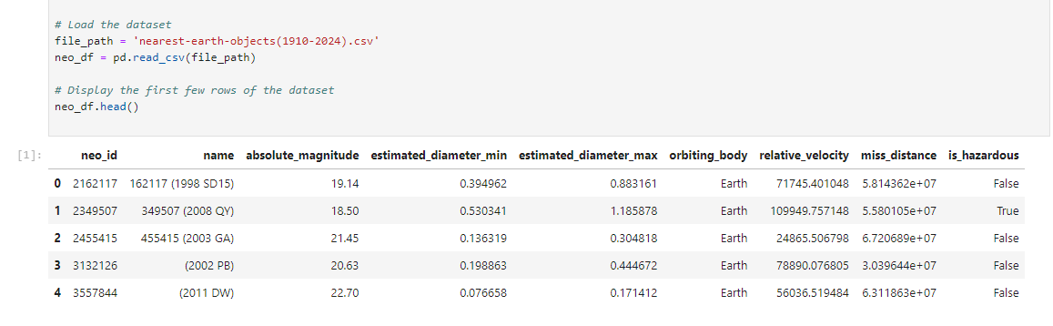
Load the Data

Slide 6
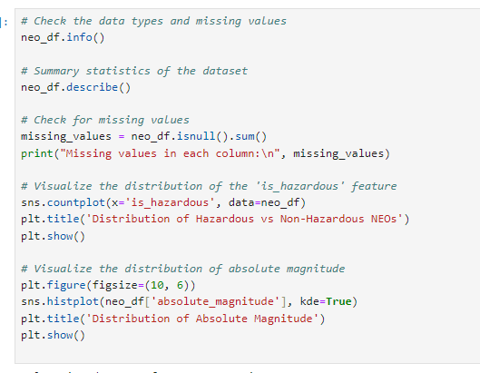
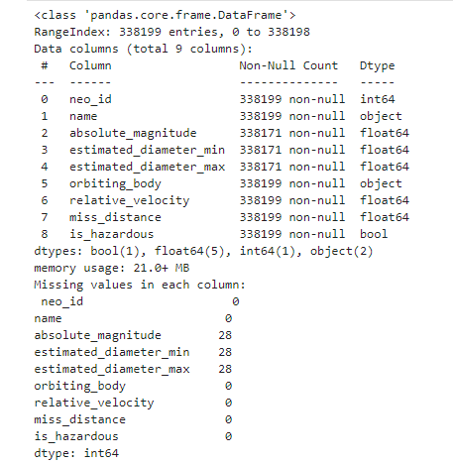
Data Cleaning and Exploratory Data Analysis (EDA)

Slide 7
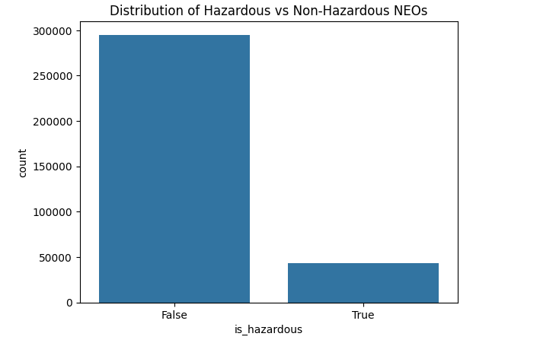
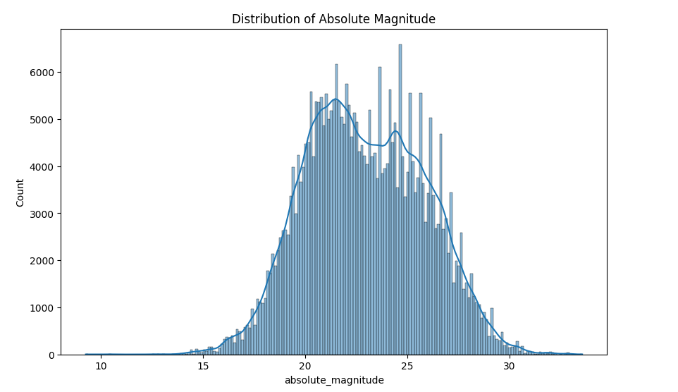
Data Cleaning and Exploratory Data Analysis (EDA)

Slide 8
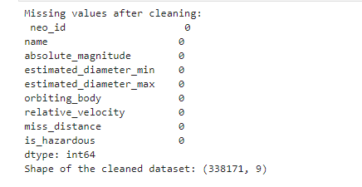
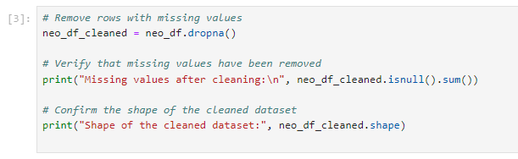
Data Cleaning

Slide 9
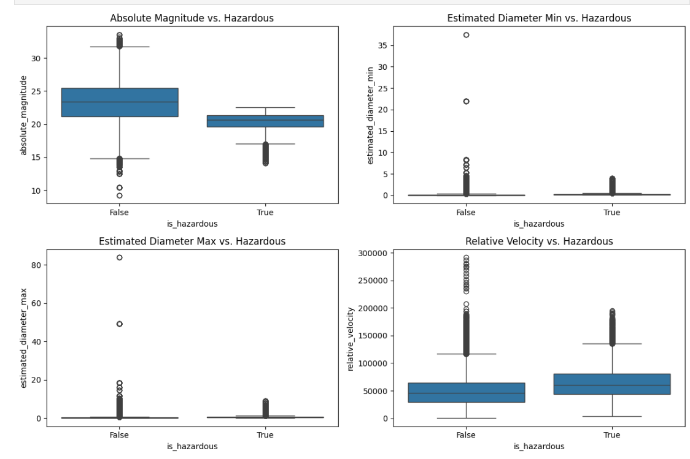
Feature Engineering & Selection

Slide 10
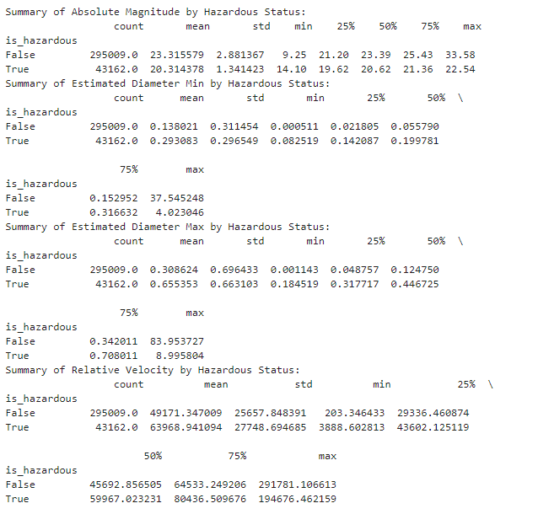
Feature Summary

Slide 11
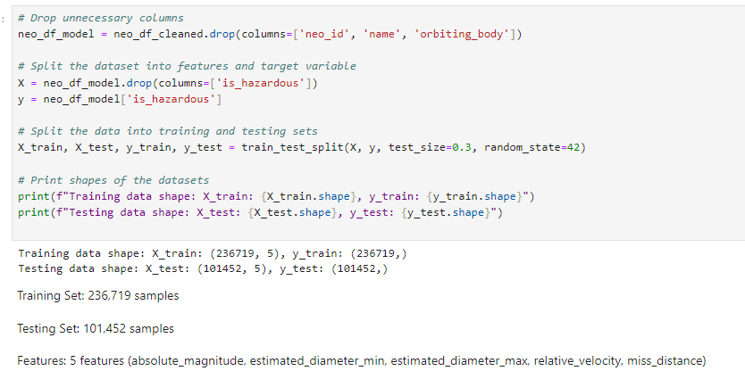
Data Preprocessing

Slide 12
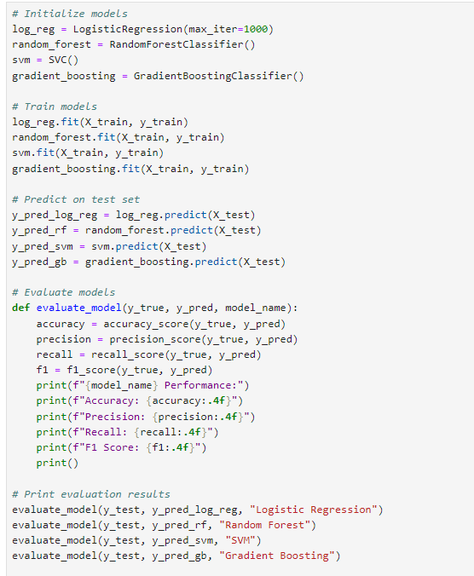
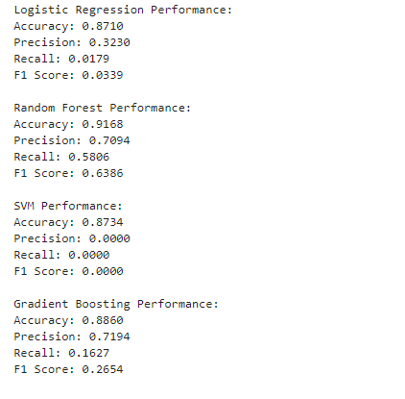
Model Building and Evaluation

Slide 13
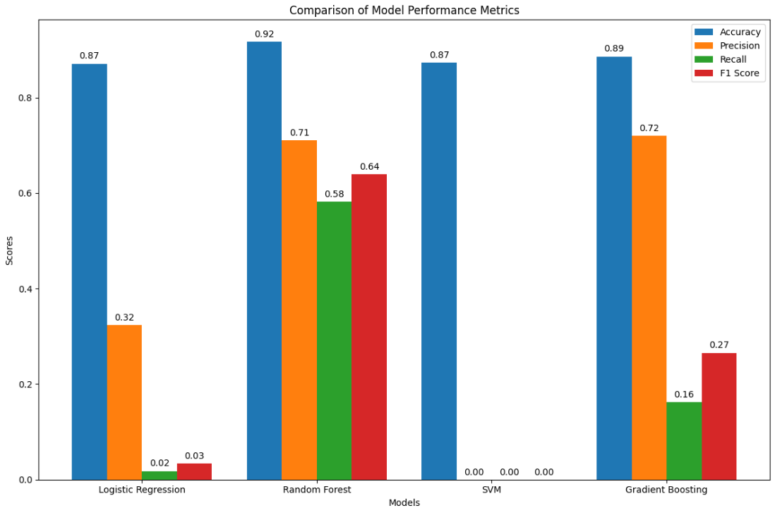
Model Performance Comparison

Slide 14
Model Improvement Strategies
Hyperparameter Tuning
Training the Final Model with Best Parameters
Comprehensive Model Evaluation

Slide 15
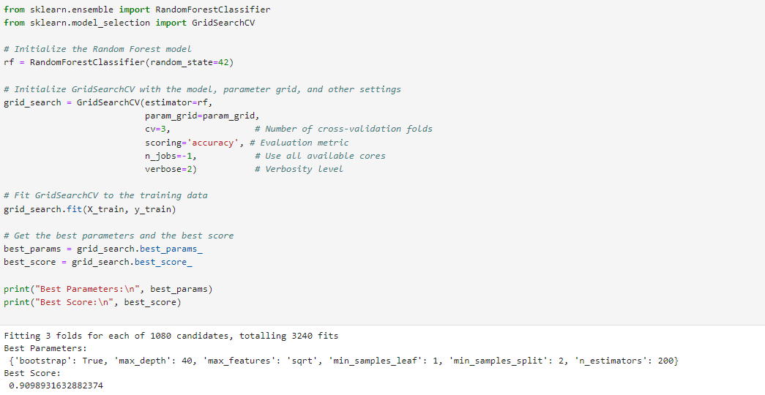
Hyperparameter Tuning

Slide 16
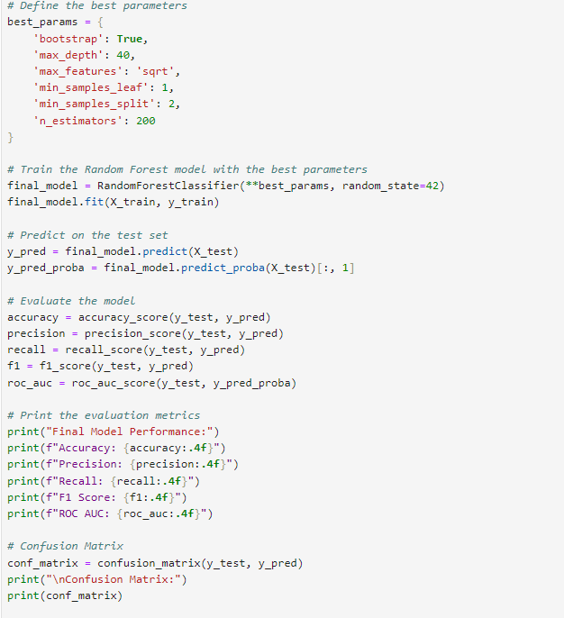
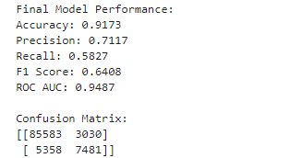
Final Random Forest Model Training and Evaluation with Best Parameters

Slide 17
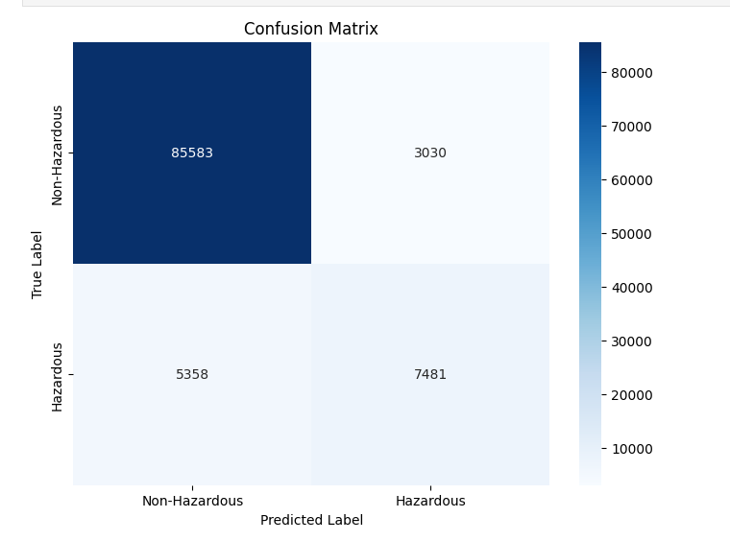
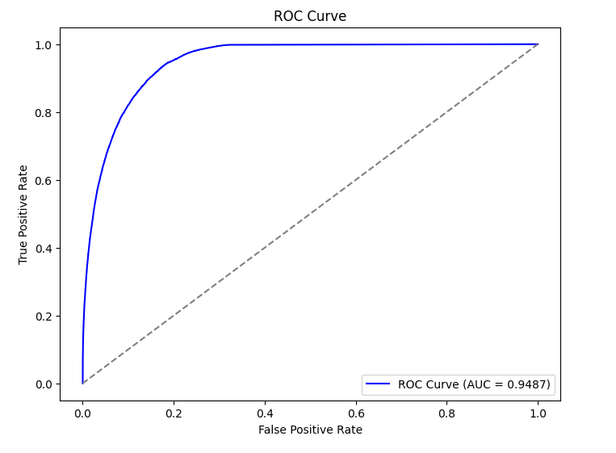
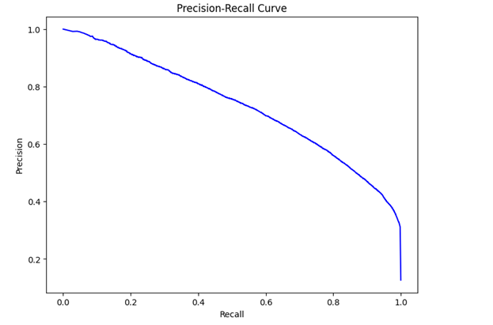
Final Model Evaluation Visualizations

Slide 18
Conclusion
Our improved Random Forest model shows strong performance in predicting hazardous NEOs. The high accuracy and AUC indicate that the model is reliable overall. However, there's still room for improvement, particularly in reducing false negatives.

